Slide 1

Informed Search
Read AIMA 3.1-3.6.
Some materials will not
be covered in lecture, but
will be on the exam.

Slide 2
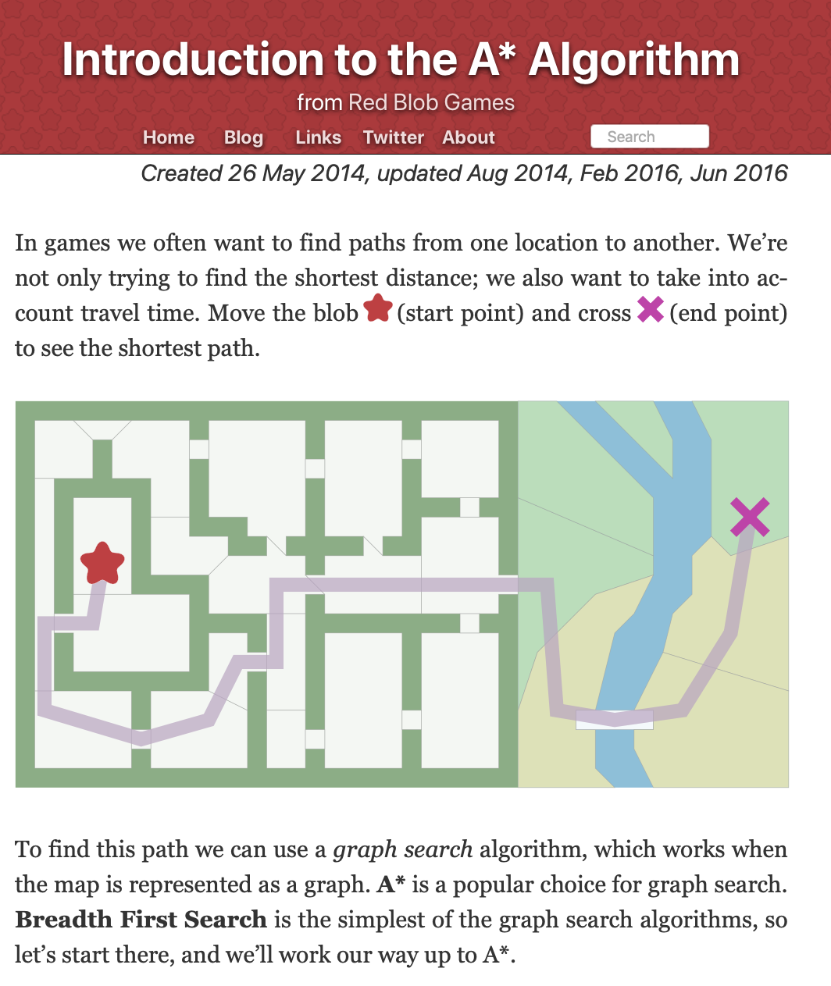
Supplemental Reading
I recommend this A* tutorial by Amit Patel of Red Blob Games
https://www.redblobgames.com/pathfinding/a-star/introduction.html

Slide 3
Reminder – HW 2 has been released
HW2 has been released. It is due on Tuesday. It is on Uninformed Search using several classic puzzles for example exercises.
My office hours are Tues/Thursday from 3-4pm in 3401 Walnut room 463C.
Plenty of additional office hours. See the course homepage for more details.

Slide 4
Review: Search problem definition
States: a set S
An initial state s_{i}∈S
Actions: a set A
∀ s Actions(s) = the set of actions that can be executed in s, that are applicable in s.
Transition Model: ∀ s∀ a∈Actions(s) Result(s, a) → s_{r}
s_{r} is called a successor of s
{s_{i} }∪ Successors(s_{i} )* = state space
Path cost (Performance Measure): Must be additive
e.g. sum of distances, number of actions executed, …
c(x,a,y) is the step cost, assumed ≥ 0
(where action a goes from state x to state y)
Goal test: Goal(s)
Can be implicit, e.g. checkmate(s)
s is a goal state if Goal(s) is true
Notes:
INITIAL STATE
2) The initial state that the agent starts in. For example, the initial state for our agent in Romania might be described as In(Arad).
ACTIONS
3) A description of the possible actions available to the agent. Given a particular state s, ACTIONS(s) returns the set of actions that can be executed in s. We say that each of APPLICABLE these actions is applicable in s. For example, from the state In(Arad), the applicable actions are {Go(Sibiu), Go(Timisoara), Go(Zerind)}.
TRANSITION MODEL
4) A description of what each action does; the formal name for this is the transition model, specified by a function RESULT(s, a) that returns the state that results from SUCCESSOR doing action a in state s. We also use the term successor to refer to any state reachable from a given state by a single action.2 For example, we have RESULT(In(Arad),Go(Zerind)) = In(Zerind).
1) STATE SPACE
Together, the initial state, actions, and transition model implicitly define the state space of the problem—the set of all states reachable from the initial state by any sequence GRAPH of actions. The state space forms a directed network or graph in which the nodes are states and the links between nodes are actions. (The map of Romania shown in Figure 3.2 can be interpreted as a state-space graph if we view each road as standing for two driving actions, one in each direction.)
5) PATH A path in the state space is a sequence of states connected by a sequence of actions.
PATH COST A path cost function that assigns a numeric cost to each path. The problem-solving agent chooses a cost function that reflects its own performance measure. For the agent trying to get to Bucharest, time is of the essence, so the cost of a path might be its length in kilometers. In this chapter, we assume that the cost of a path can be described as the sum of the costs of the individual actions along the path. STEP COST The step cost of taking action a in state s to reach state s is denoted by c(s, a, s). The step costs for Romania are shown in Figure 3.2 as route distances. We assume that step costs are nonnegative.
6) GOAL TEST • The goal test, which determines whether a given state is a goal state. Sometimes there is an explicit set of possible goal states, and the test simply checks whether the given state is one of them. The agent’s goal in Romania is the singleton set {In(Bucharest)}. Sometimes the goal is specified by an abstract property rather than an explicitly enumerated set of states. For example, in chess, the goal is to reach a state called “checkmate,” where the opponent’s king is under attack and can’t escape.

Slide 5
Review: Useful Concepts
State space: the set of all states reachable from the initial state by any sequence of actions
When several operators can apply to each state, this gets large very quickly
Might be a proper subset of the set of configurations
Path: a sequence of actions leading from one state s_{j} to another state s_{k}
Frontier: those states that are available for expanding (for applying legal actions to)
Solution: a path from the initial state s_{i} to a state s_{g} that satisfies the goal test

Slide 6
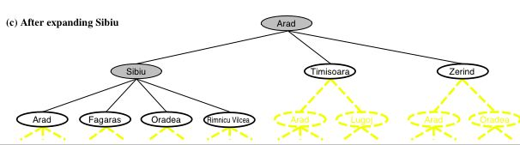
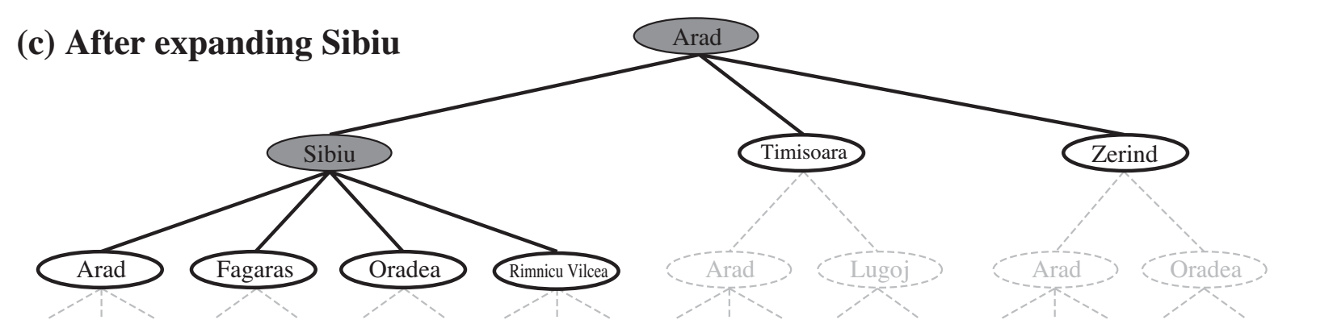
Review: Tree search
function TREE-SEARCH(problem, strategy) return a solution or failure
Initialize frontier to the initial state of the problem
do
if the frontier is empty then return failure
choose leaf node for expansion according to strategy & remove from frontier
if node contains goal state then return solution
else expand the node and add resulting nodes to the frontier
Determines search process!!
6
Notes:
Shaded nodes are the ones that have been expanded
Nodes that have been generated by not yet expanded are outlined in bold.
Others are in dashed yellow lines
There’s a loop if we expand Arad again. Is that good

Slide 7
Review: Search Strategies
Strategy = order of tree expansion
Implemented by different queue structures (LIFO, FIFO, priority)
Dimensions for evaluation
Completeness- always find the solution?
Optimality - finds a least cost solution (lowest path cost) first?
Time complexity - # of nodes generated (worst case)
Space complexity - # of nodes simultaneously in memory (worst case)
Time/space complexity variables
b, maximum branching factor of search tree
d, depth of the shallowest goal node
m, maximum length of any path in the state space (potentially ∞)

Slide 8
Review: Breadth-first search
Strategy:
Expand shallowest unexpanded node
Implementation:
frontier is FIFO (First-In-First-Out) Queue:
Put successors at the end of frontier successor list.
Image credit: Dan Klein and Pieter Abbeel
http://ai.berkeley.edu

Slide 9

Review: Depth-first search
Strategy:
Expand deepest unexpanded node
Implementation:
frontier is LIFO (Last-In-First-Out) Queue:
Put successors at the front of frontier successor list.
Image credit: Dan Klein and Pieter Abbeel
http://ai.berkeley.edu

Slide 10
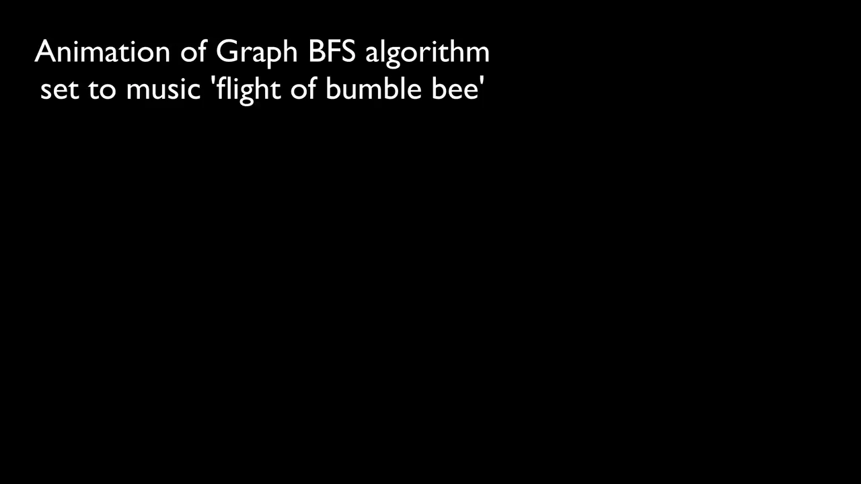
Breadth first search
https://youtu.be/x-VTfcmrLEQ
Notes:
https://youtu.be/x-VTfcmrLEQ

Slide 11
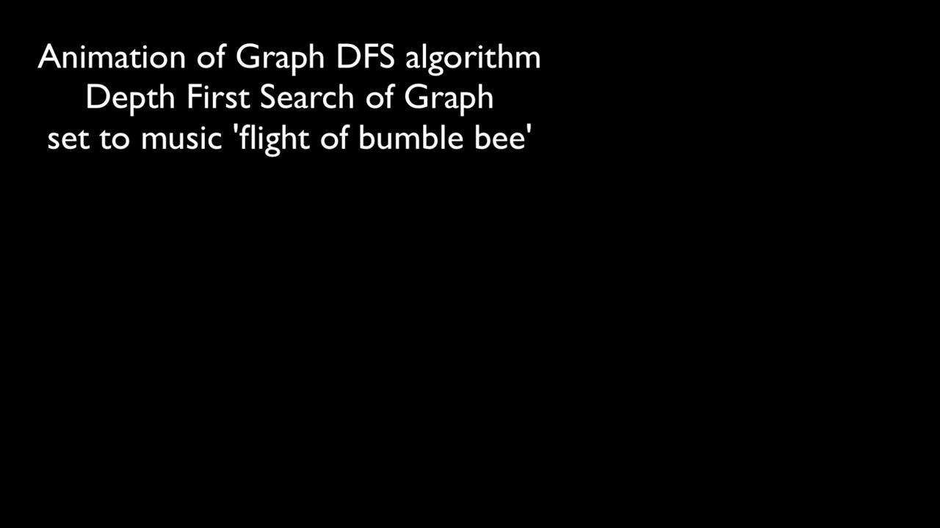
Depth first search
https://y2mate.com/youtube/NUgMa5coCoE
https://youtu.be/NUgMa5coCoE
Notes:
https://youtu.be/x-VTfcmrLEQ?t=7s

Slide 12

Fringe Strategies with One Queue
These search algorithms are the same except for fringe strategies
DFS strategy = LIFO stack
BSF strategy = FIFO queue
Conceptually, all fringes are priority queues (i.e. collections of nodes with attached priorities)
You can even code one implementation that takes a variable queuing object
Slide credit: Dan Klein and Pieter Abbeel
http://ai.berkeley.edu

Slide 13
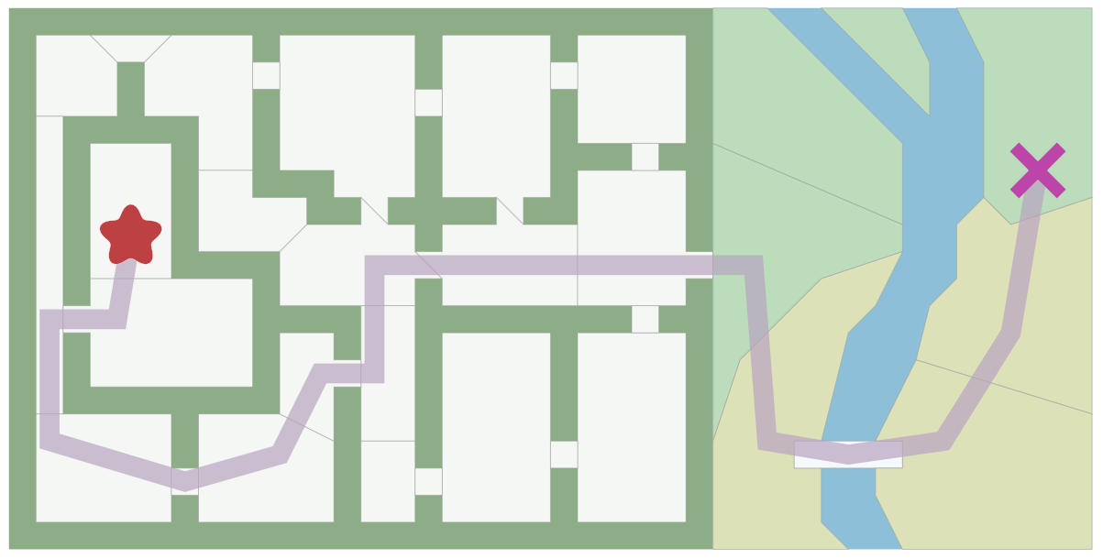
Pathfinding in Games
https://www.redblobgames.com/pathfinding/a-star/introduction.html

Slide 14
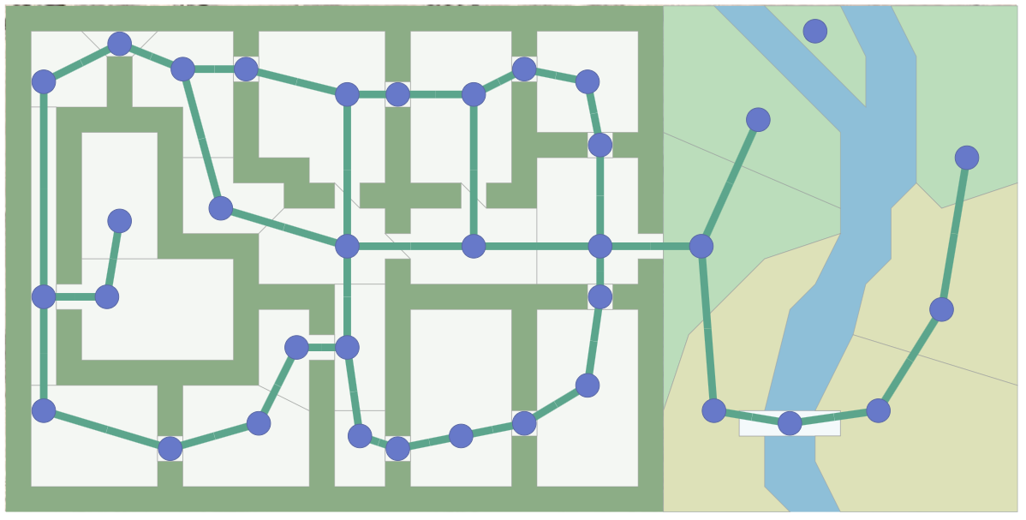
Pathfinding in Games
https://www.redblobgames.com/pathfinding/a-star/introduction.html
Notes:
Input: Graph search algorithms, including A*, take a “graph” as input. A graph is a set of locations (“nodes”) and the connections (“edges”) between them.

Slide 15
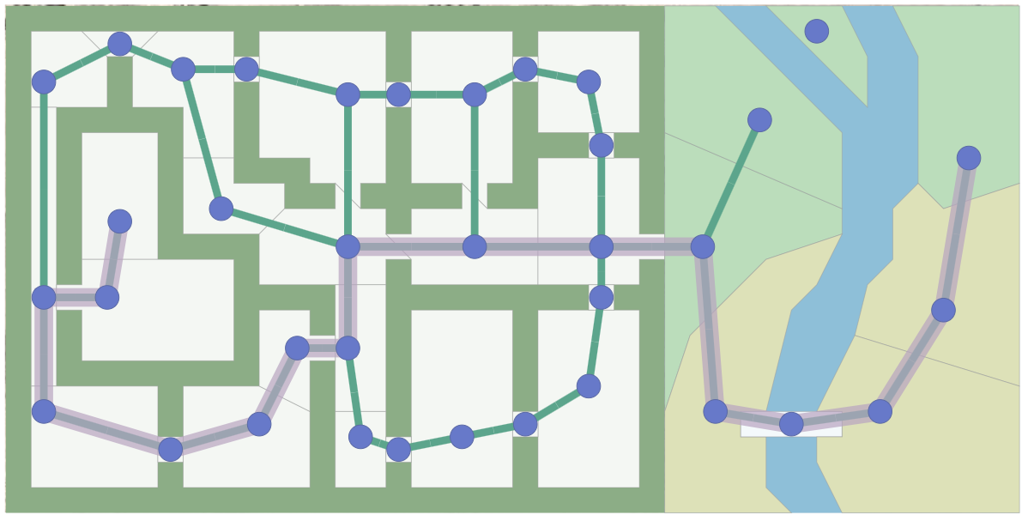
Pathfinding in Games
https://www.redblobgames.com/pathfinding/a-star/introduction.html
Notes:
Output is a path: The path found by the algorithm. A sequence of actions.

Slide 16
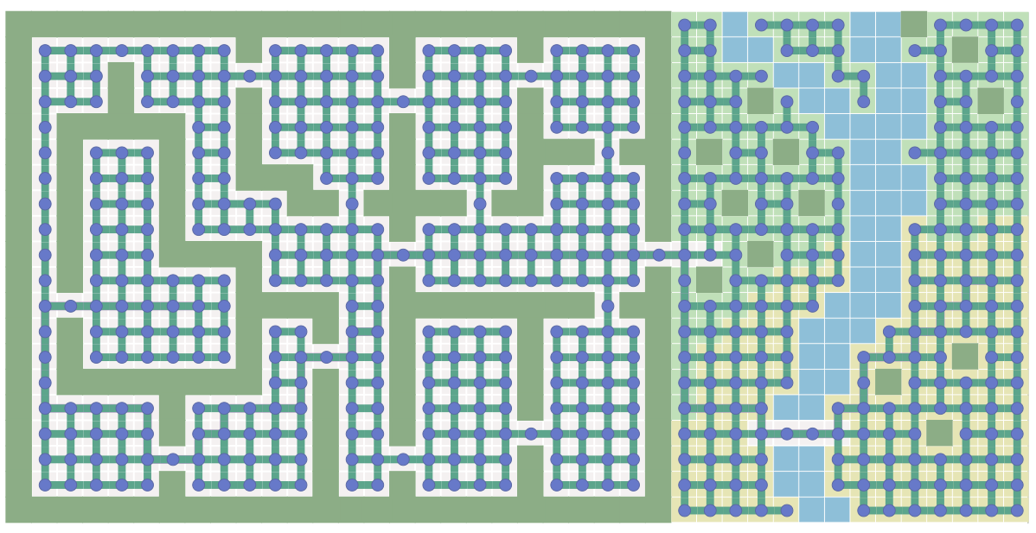
Pathfinding in Games
https://www.redblobgames.com/pathfinding/a-star/introduction.html

Slide 17
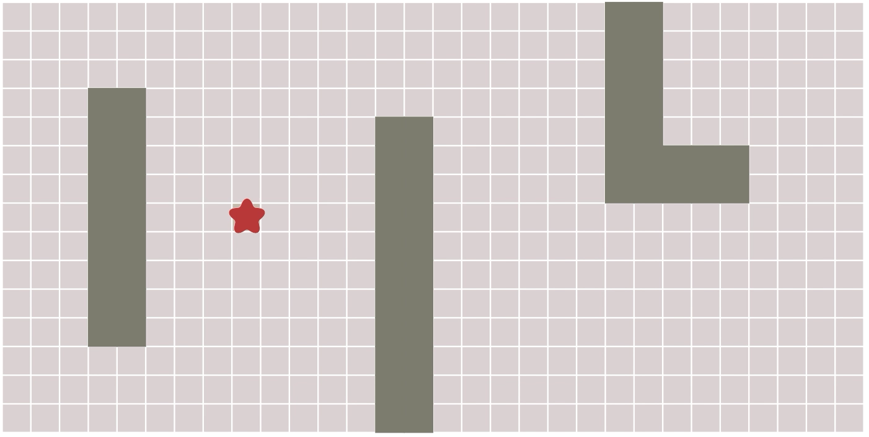
Breadth First Search
https://www.redblobgames.com/pathfinding/a-star/introduction.html

Slide 18
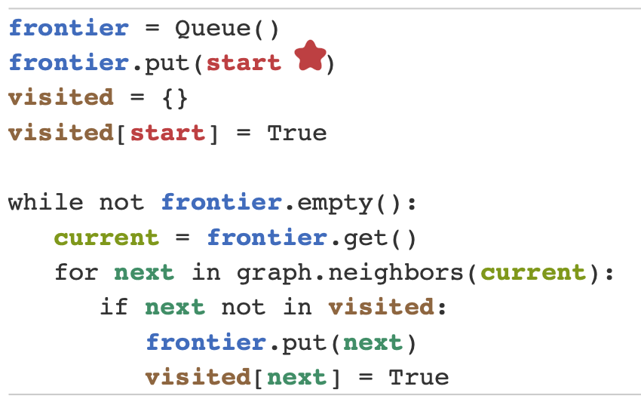
BSF in 10 lines of Python
https://www.redblobgames.com/pathfinding/a-star/introduction.html

Slide 19
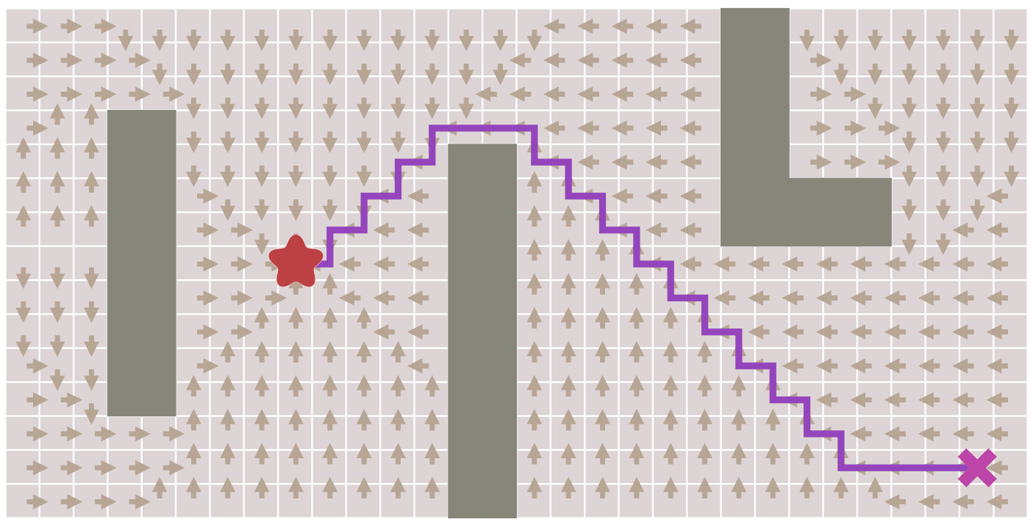
BSF in 10 lines of Python
https://www.redblobgames.com/pathfinding/a-star/introduction.html

Slide 20
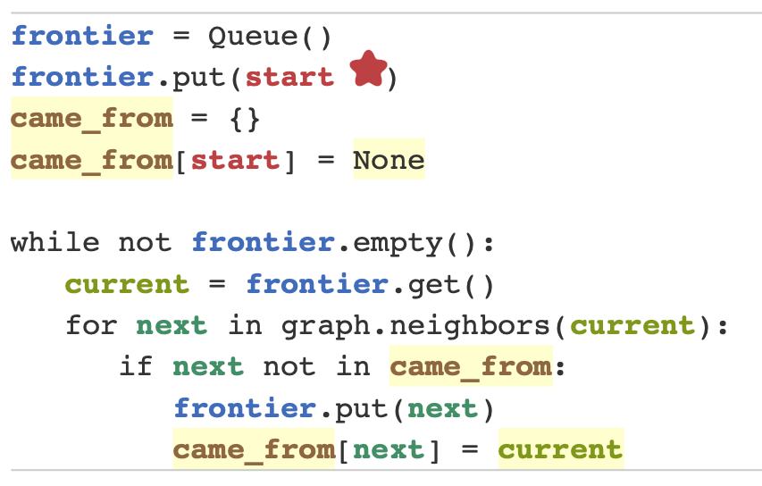
BSF in 10 lines of Python
https://www.redblobgames.com/pathfinding/a-star/introduction.html
Notes:
Here though we want to use it for finding paths, so let’s modify the loop to keep track of where we came from for every location that’s visited, and rename the visited set to a came_from table (the keys of the table are the visited set).
Now came_from for each location points to the place where we came from. These are like “breadcrumbs”. They’re enough to reconstruct the entire path

Slide 21
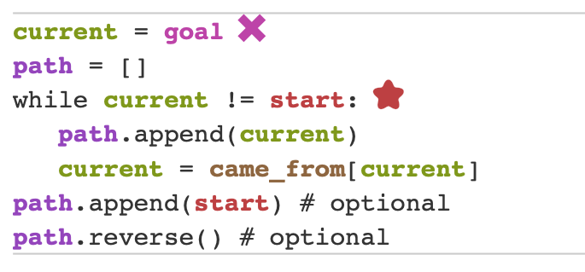
BSF in 10 lines of Python

Slide 22
“Uniform Cost” Search
“In computer science, uniform-cost search (UCS) is a tree search algorithm used for traversing or searching a weighted tree, tree structure, or graph.” - Wikipedia
Notes:
22
Dijkstra’s algorithm just UCS without goal.

Slide 23
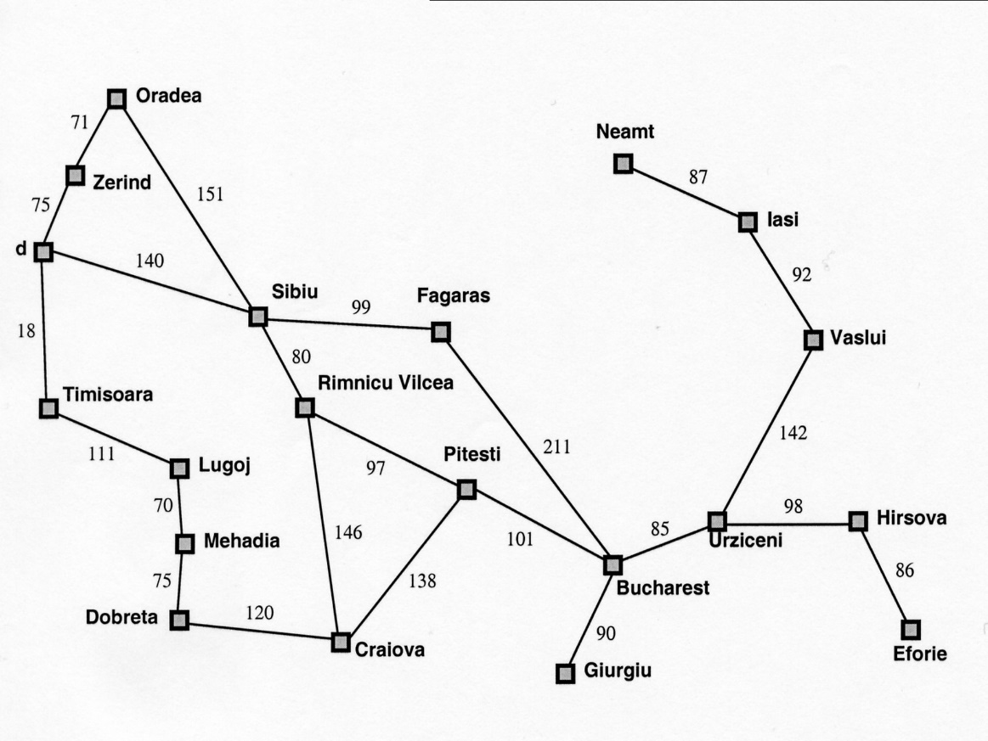
Motivation: Romanian Map Problem
Arad
118
All our search methods so far assume step-cost = 1
This is only true for some problems
Notes:
Dijkstra’s algorithm just UCS without goal.

Slide 24
g(N): the path cost function
Our assumption so far: All moves equal in cost
Cost = # of nodes in path-1
g(N) = depth(N) in the search tree
More general: Assigning a (potentially) unique cost to each step
N₀, N₁, N₂, N₃ = nodes visited on path p from N₀ to N₃
C(i,j): Cost of going from N_{i} to N_{j}
If N₀ the root of the search tree, g(N3)=C(0,1)+C(1,2)+C(2,3)

Slide 25
Uniform-cost search (UCS)
Extension of BF-search:
Expand node with lowest path cost
Implementation: frontier = priority queue ordered by g(n)
Subtle but significant difference from BFS:
Tests if a node is a goal state when it is selected for expansion, not when it is added to the frontier.
Updates a node on the frontier if a better path to the same state is found.
So always enqueues a node before checking whether it is a goal.
WHY???

Slide 26


Shape of Search
Breadth First Search explores equally in all directions. It’s frontier is implemented as a FIFO queue. This results in smooth contours or “plys”.
Uniform Cost Search lets us prioritize which paths to explore. Instead of exploring all possible paths equally, it favors lower cost paths. It’s frontier is a priority queue. This results in “cost contours”.
Notes:
Shapes from https://www.redblobgames.com/pathfinding/a-star/introduction.html

Slide 27
Uniform Cost Search
Slide from Stanford CS 221 (from slide by Dan Klein (UCB) and many others)
Expand cheapest node first:
Frontier is a priority queue
No longer ply at a time, but follows cost contours
Therefore: Must be optimal
2
G
a
b
1
8
c
2
2
3
d
e
f
9
8
1
S
h
1
1
p
q
r
15
S
0
d
3
e
9
p
1
b
4
c
e
5
h
17
r
11
q
16
11
Cost contours
a
6
a
h
13
r
7
p
q
f
p
q
f
8
q
c
G
q
c
a
11
G
10
a
Notes:
NOTE: Dijkstra’s algorithm just UCS without goal

Slide 28
Complexity of UCS
Complete!
Optimal!
if the cost of each step exceeds some positive bound ε.
Time complexity: O(b^{C*/ε + 1})
Space complexity: O(b^{C*/ε + 1})
where C* is the cost of an optimal solution, and ε is min(C(i,j))
(if all step costs are equal, this becomes O(b^{d+1})
NOTE: Dijkstra’s algorithm just UCS without goal

Slide 29
Summary of algorithms (for notes)
Criterion | Breadth-First | Uniform-cost | Depth-First | Depth-limited | Iterative deepening | Bidirectional search
Complete? | YES | YES | NO | NO | YES | YES
Time | b^{d} | b^{(C*/e)+1} | b^{m} | b^{l} | b^{d} | b^{d/2}
Space | b^{d} | b^{(C*/e)+1} | bm | bl | bd | b^{d/2}
Optimal? | YES | YES | NO | NO | YES | YES
Assumes b is finite

Slide 30
Outline for today’s lecture
Uninformed Search
Briefly: Bidirectional Search
“Uniform Cost” Search (UCS)
Informed Search
Introduction to Informed search
Heuristics
1st attempt: Greedy Best-first search

Slide 31

Is Uniform Cost Search the best we can do? Consider finding a route from Bucharest to Arad..
g(n)<300
Arad
g(n)<200
118
g(n)<100

Slide 32
Is Uniform Cost Search the best we can do? Consider finding a route from Bucharest to Arad..
g(n)<300
Arad
118
g(n)<200
g(n)<100
WRONG
WAY!!!!

Slide 33
A Better Idea…
Node expansion based on an estimate which includes distance to the goal
General approach of informed search:
Best-first search: node selected for expansion based on an evaluation function f(n)
f(n) includes estimate of distance to goal (new idea!)
Implementation: Sort frontier queue by this new f(n).
Special cases: greedy search, and A* search

Slide 34
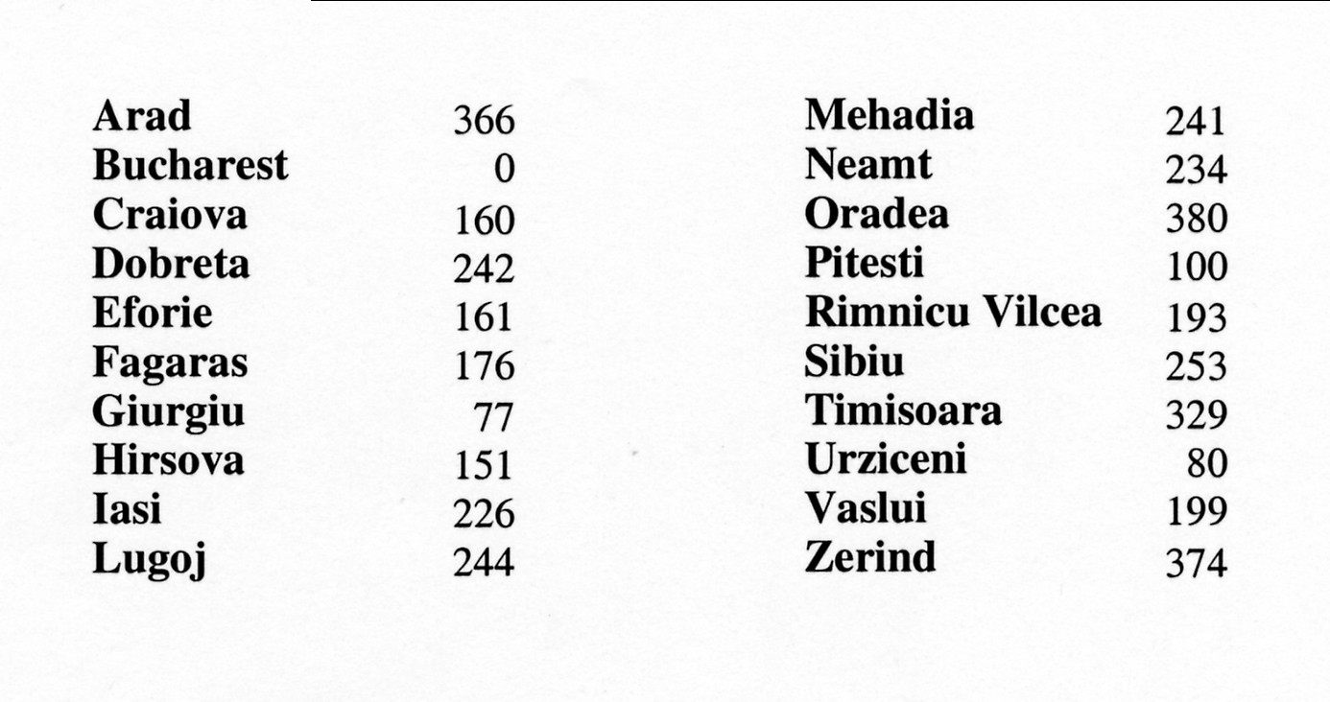
Simple, useful estimate heuristic: straight-line distances
Arad
118

Slide 35

Heuristic (estimate) functions
Heureka! ---Archimedes
[dictionary]“A rule of thumb, simplification, or educated guess that reduces or limits the search for solutions in domains that are difficult and poorly understood.”
Heuristic knowledge is useful, but not necessarily correct.
Heuristic algorithms use heuristic knowledge to solve a problem.
A heuristic function h(n) takes a state n and returns an estimate of the distance from n to the goal.
(graphic: http://hyperbolegames.com/2014/10/20/eureka-moments/)

Slide 36
Outline for today’s lecture
Uninformed Search
Briefly: Bidirectional Search
“Uniform Cost” Search (UCS)
Informed Search
Introduction to Informed search
Heuristics
1st attempt: Greedy Best-first search (AIMA 3.5.1)

Slide 37
Review: Best-first search
Basic idea:
select node for expansion with minimal evaluation function f(n)
where f(n) is some function that includes estimate heuristic h(n) of the remaining distance to goal
Implement using priority queue
Exactly UCS with f(n) replacing g(n)

Slide 38
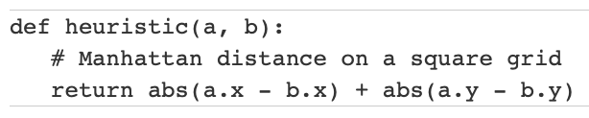
Greedy best-first search: f(n) = h(n)
Expands the node that is estimated to be closest to goal
Completely ignores g(n): the cost to get to n
In our Romanian map, h(n) = h_{SLD}(n) = straight-line distance from n to Bucharest
In a grid, the heuristic distance can be calculated using the “Manhattan distance”:

Slide 39
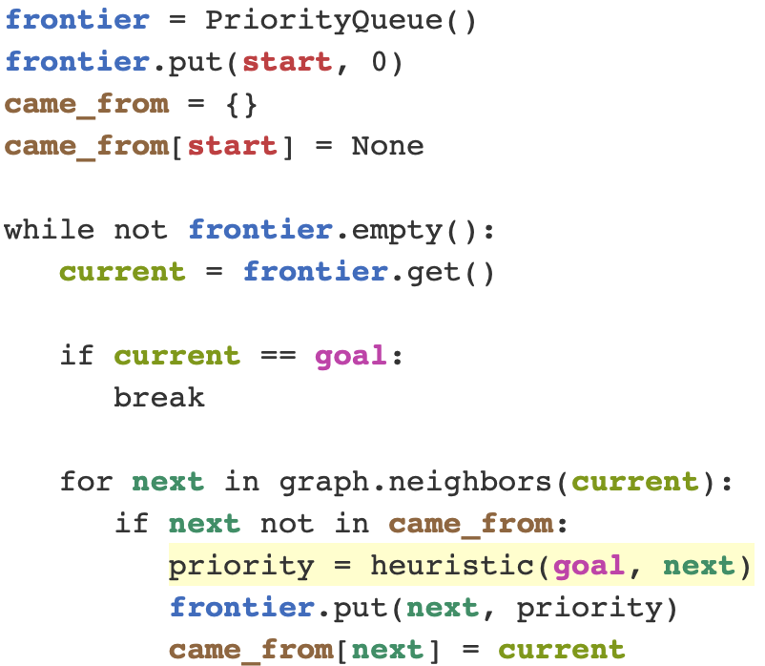
Greedy best-first search
Code from Amit Patel
of Red Blob Games

Slide 40
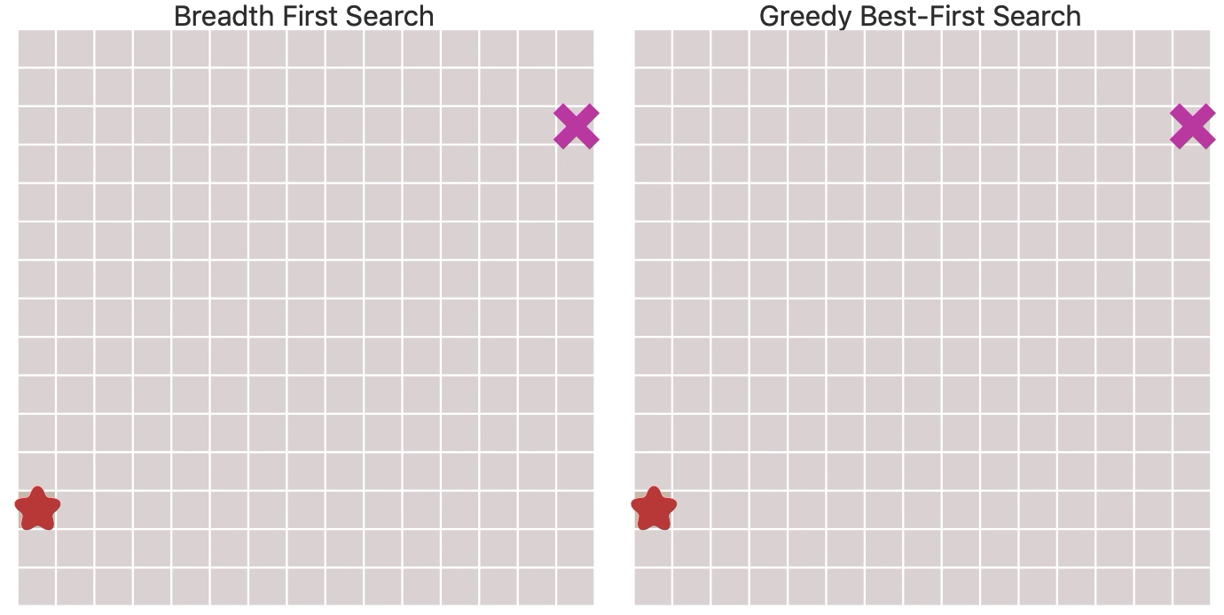
BFS v. Greedy Best-First Search
https://www.redblobgames.com/pathfinding/a-star/introduction.html

Slide 41

Greedy best-first search example
Frontier queue:
Arad 366
Initial State = Arad
Goal State = Bucharest
Notes:
Ccb – show slide 17 on the second screen.

Slide 42

Greedy best-first search example
Frontier queue:
Sibiu 253
Timisoara 329
Zerind 374

Slide 43

Greedy best-first search example
Frontier queue:
Fagaras 176
Rimnicu Vilcea 193
Timisoara 329
Arad 366
Zerind 374
Oradea 380

Slide 44

Greedy best-first search example
Frontier queue:
Bucharest 0
Rimnicu Vilcea 193
Sibiu 253
Timisoara 329
Arad 366
Zerind 374
Oradea 380
Goal reached !!

Slide 45
Properties of greedy best-first search
Optimal?
No!
Found: Arad → Sibiu → Fagaras → Bucharest (450km)
Shorter: Arad → Sibiu → Rimnicu Vilcea → Pitesti→ Bucharest (418km)
Arad
118

Slide 46
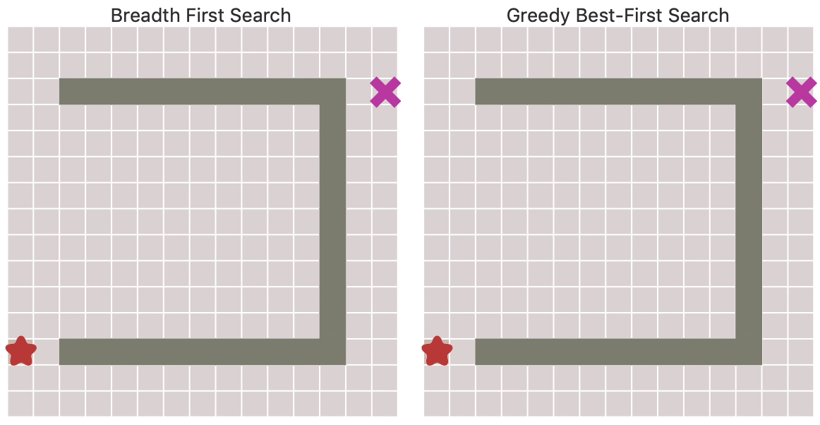
BFS v. Greedy Best-First Search
https://www.redblobgames.com/pathfinding/a-star/introduction.html

Slide 47
Properties of greedy best-first search
Complete?
No – can get stuck in loops,
e.g., Iasi → Neamt → Iasi → Neamt →…
Initial
Goal

Slide 48
Properties of greedy best-first search
Complete? No – can get stuck in loops,
e.g., Iasi → Neamt → Iasi → Neamt → …
Time? O(b^{m}) – worst case (like Depth First Search)
But a good heuristic can give dramatic improvement of average cost
Space? O(b^{m}) – priority queue, so worst case: keeps all (unexpanded) nodes in memory
Optimal? No

Slide 49
IF TIME
Optimal informed search: A* (AIMA 3.5.2)

Slide 50
A* search
Best-known form of best-first search.
Key Idea: avoid expanding paths that are already expensive, but expand most promising first.
Simple idea: f(n)=g(n) + h(n)
g(n) the actual cost (so far) to reach the node
h(n) estimated cost to get from the node to the goal
f(n) estimated total cost of path through n to goal
Implementation: Frontier queue as priority queue by increasing f(n) (as expected…)

Slide 51
Key concept: Admissible heuristics
A heuristic h(n) is admissible if it never overestimates the cost to reach the goal; i.e. it is optimistic
Formally:∀n, n a node:
h(n) ≤ h*(n) where h*(n) is the true cost from n
h(n) ≥ 0 so h(G)=0 for any goal G.
Example: h_{SLD}(n) never overestimates the actual road distance
Theorem: If h(n) is admissible, A* using Tree Search is optimal

Slide 52
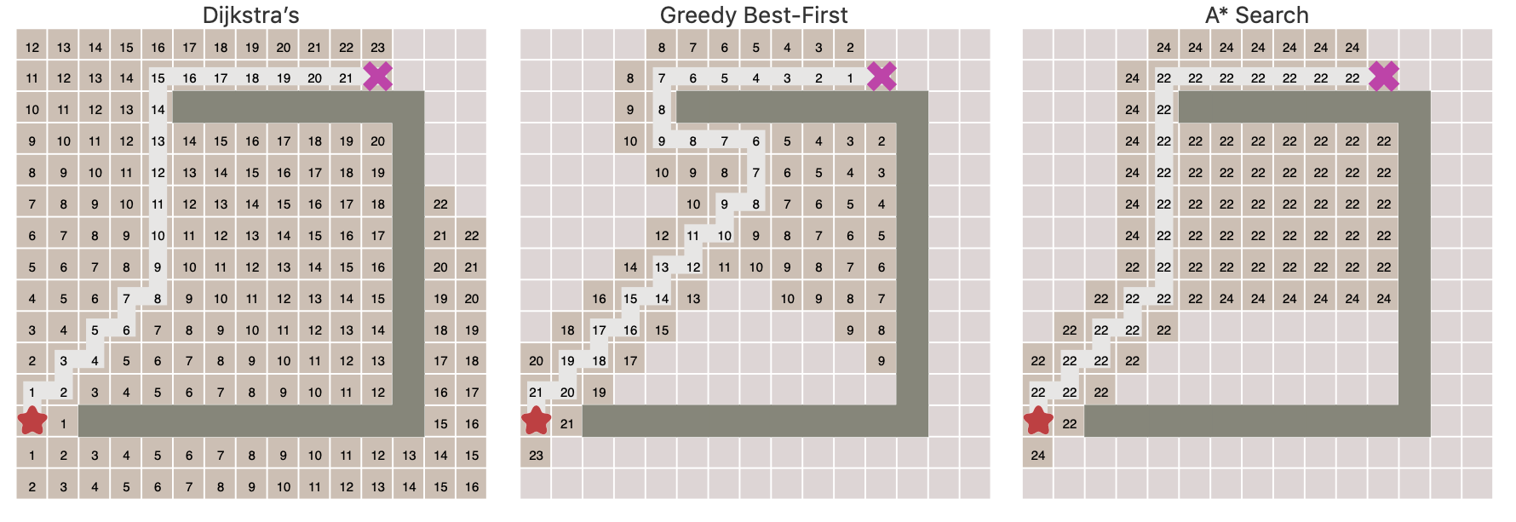
A* is optimal with admissible heruistic
https://www.redblobgames.com/pathfinding/a-star/introduction.html

Slide 53


Idea: Admissibility
Inadmissible (pessimistic) heuristics break optimality by trapping good plans on the fringe
Admissible (optimistic) heuristics slow down bad plans but never outweigh true costs
Slide credit: Dan Klein and Pieter Abbeel
http://ai.berkeley.edu
Notes:
Admissibility has to be true of every state in your state space. If there’s any state for which it’s not true, then we might make the true best past seem too bad to appear at the top of the priority queue.

Slide 54

A* search example
Frontier queue:
Arad 366

Slide 55

A* search example
Frontier queue:
Sibiu 393
Timisoara 447
Zerind 449
We add the three nodes we found to the Frontier queue.
We sort them according to the g()+h() calculation.

Slide 56

A* search example
Frontier queue:
Rimricu Vicea 413
Fagaras 415
Timisoara 447
Zerind 449
Arad 646
Oradea 671
When we expand Sibiu, we run into Arad again. Note that we’ve already expanded this node once; but we still add it to the Frontier queue again.

Slide 57

A* search example
Frontier queue:
Fagaras 415
Pitesti 417
Timisoara 447
Zerind 449
Craiova 526
Sibiu 553
Arad 646
Oradea 671
We expand Rimricu Vicea.

Slide 58

A* search example
Frontier queue:
Pitesti 417
Timisoara 447
Zerind 449
Bucharest 450
Craiova 526
Sibiu 553
Sibiu 591
Arad 646
Oradea 671
When we expand Fagaras, we find Bucharest, but we’re not done. The algorithm doesn’t end until we “expand” the goal node – it has to be at the top of the Frontier queue.

Slide 59

A* search example
Frontier queue:
Frontier queue:
Bucharest 418
Timisoara 447
Zerind 449
Bucharest 450
Craiova 526
Sibiu 553
Sibiu 591
Rimricu Vicea 607
Craiova 615
Arad 646
Oradea 671
Note that we just found a better value for Bucharest!
Now we expand this better value for Bucharest since it’s at the top of the queue.
We’re done and we know the value found is optimal!

Slide 60
Outline for today’s lecture
Informed Search
Optimal informed search: A*
Creating good heuristic functions (AIMA 3.6)
Hill Climbing

Slide 61
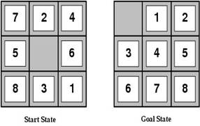
Heuristic functions
For the 8-puzzle
Avg. solution cost is about 22 steps
(branching factor ≤ 3)
Exhaustive search to depth 22: 3.1 x 10¹⁰ states
A good heuristic function can reduce the search process
Notes:
Exhaustive search like BFS

Slide 62

Example Admissible heuristics
For the 8-puzzle:
h_{oop}(n) = number of out of place tiles
h_{md}(n) = total Manhattan distance (i.e., # of moves from desired location of each tile)
h_{oop}(S) = 8
h_{md}(S) = 3+1+2+2+2+3+3+2 = 18
Notes:
OOP = out of place
MD = Manhattan distance. Let’s assume that I can move single squares. Start with tile 1. Needs to move up up, left = 3 moves.

Slide 63
Relaxed problems
A problem with fewer restrictions on the actions than the original is called a relaxed problem
The cost of an optimal solution to a relaxed problem is an admissible heuristic for the original problem
If the rules of the 8-puzzle are relaxed so that a tile can move anywhere, then h_{oop}(n) gives the shortest solution
If the rules are relaxed so that a tile can move to any adjacent square, then h_{md}(n) gives the shortest solution

Slide 64
Defining Heuristics: h(n)
Cost of an exact solution to a relaxed problem (fewer restrictions on operator)
Constraints on Full Problem:
A tile can move from square A to square B if A is adjacent to B and B is blank.
Constraints on relaxed problems:
A tile can move from square A to square B if A is adjacent to B. (h_{md})
A tile can move from square A to square B if B is blank.
A tile can move from square A to square B. (h_{oop})
Notes:
Two constraints (in blue and in red).
Drop one or drop both.

Slide 65
Dominance: A metric on better heuristics
If h₂(n) ≥ h₁(n) for all n (both admissible)
then h₂ dominates h₁
So h₂ is optimistic, but more accurate than h₁
h₂ is therefore better for search
Notice: h_{md} dominates h_{oop}
Typical search costs (average number of nodes expanded):
d=12 Iterative Deepening Search = 3,644,035 nodes A*(h_{oop}) = 227 nodes A*(h_{md}) = 73 nodes
d=24 IDS = too many nodes A*(h_{oop}) = 39,135 nodes A*(h_{md}) = 1,641 nodes
Notes:
h2 dominates h1 if ….
h2 is still optimistic, but it’s closer to the truth than h1.
Manhattan distance dominates out of place.

Slide 66
The best and worst admissible heuristics
h*(n) - the (unachievable) Oracle heuristic
h*(n) = the true distance from the root to n
h_{we’re here already}(n)= h_{teleportation}(n)=0
Admissible: both yes!!!
h*(n) dominates all other heuristics
h_{teleportation}(n) is dominated by all heuristics

Slide 67

Optimality of A* Tree Search
Slide credit: Dan Klein and Pieter Abbeel
http://ai.berkeley.edu

Slide 68
Admissibility
Inadmissible (pessimistic) heuristics break optimality by trapping good plans on the fringe
Admissible (optimistic) heuristics slow down bad plans but never outweigh true costs
Slide credit: Dan Klein and Pieter Abbeel
http://ai.berkeley.edu
Notes:
Optimistic must be true of every state in your state space. If any state is an not optimistic estimate, then heuristic is inadmissible.

Slide 69


Admissible Heuristics
A heuristic h is admissible (optimistic) if:
where is the true cost to a nearest goal
Is Manhattan Distance admissible?
Coming up with admissible heuristics is most of what’s involved in using A* in practice.
Notes:
h*(n) is the cheapest way of reaching your goal.
h(n) must be positive.
Yes, Manhattan Distance is admissible. Ask students why?

Slide 70


Optimality of A* Tree Search
Assume:
A is an optimal goal node
B is a suboptimal goal node
h is admissible
Claim:
A will exit the fringe before B
…
Slide credit: Dan Klein and Pieter Abbeel
http://ai.berkeley.edu
Notes:
Claim we will prove first. If we can prove this then we know we’ve found an optimal path to the goal.

Slide 71




Optimality of A* Tree Search: Blocking
Proof:
Imagine B is on the fringe
Some ancestor n of A is on the fringe, too (maybe A!)
Claim: n will be expanded before B
f(n) is less or equal to f(A)
…
Definition of f-cost
Admissibility of h
h = 0 at a goal
Slide credit: Dan Klein and Pieter Abbeel
http://ai.berkeley.edu
Notes:
We always have some ancestor of A, since we will either have the root, or some child that expands from it and leads to A. (It could be A itself)

Slide 72


Optimality of A* Tree Search: Blocking
Proof:
Imagine B is on the fringe
Some ancestor n of A is on the fringe, too (maybe A!)
Claim: n will be expanded before B
f(n) is less or equal to f(A)
f(A) is less than f(B)
…
B is suboptimal
h = 0 at a goal
Slide credit: Dan Klein and Pieter Abbeel
http://ai.berkeley.edu

Slide 73

Optimality of A* Tree Search: Blocking
Proof:
Imagine B is on the fringe
Some ancestor n of A is on the fringe, too (maybe A!)
Claim: n will be expanded before B
f(n) is less or equal to f(A)
f(A) is less than f(B)
n expands before B
All ancestors of A expand before B
A expands before B
A* search is optimal
…
Slide credit: Dan Klein and Pieter Abbeel
http://ai.berkeley.edu

Slide 74
Properties of A*
Slide credit: Dan Klein and Pieter Abbeel
http://ai.berkeley.edu
Notes:
A* is optimal with an admissible heuristic.

Slide 75
Properties of A*
Uniform-Cost
A*
b
b
…
…
Slide credit: Dan Klein and Pieter Abbeel
http://ai.berkeley.edu
Notes:
A* targets goal states more directly than UCS

Slide 76
UCS vs A* Contours
Uniform-cost expands equally in all “directions”
A* expands mainly toward the goal, but does hedge its bets to ensure optimality
Start
Goal
Start
Goal
Slide credit: Dan Klein and Pieter Abbeel
http://ai.berkeley.edu

Slide 77
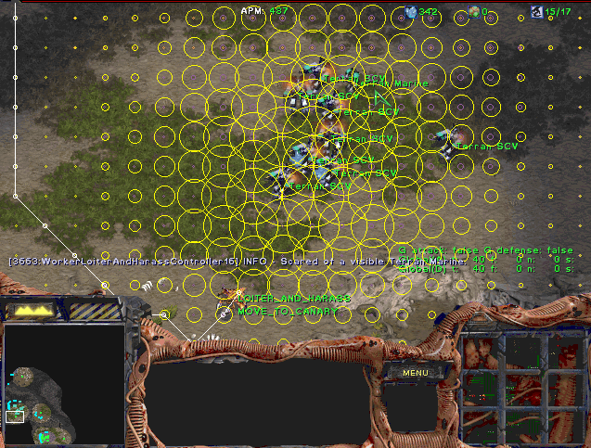
A* Applications
Video games
Pathing / routing problems (A* is in your GPS!)
Resource planning problems
Robot motion planning
…
Slide credit: Dan Klein and Pieter Abbeel
http://ai.berkeley.edu
Notes:
A lot of games where you have to move troops around using A*

Slide 78
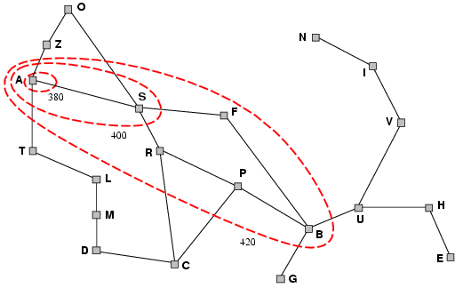
Optimality of A* (intuitive)
Lemma: A* expands nodes on frontier in order of increasing f value
Gradually adds "f-contours" of nodes
Contour i has all nodes with f=f_{i}, where f_{i} < f_{i+1}
(After all, A* is just a variant of uniform-cost search….)

Slide 79
Optimality of A* using Tree-Search (proof idea )
Lemma: A* expands nodes on frontier in order of increasing f value
Suppose some suboptimal goal G₂ (i.e a goal on a suboptimal path) has been generated and is in the frontier along with an optimal goal G.
Must prove: f(G₂) > f(G)
(Why? Because if f(G₂) > f(n), then G₂ will never get to the front of the priority queue.)
Proof:
g(G₂) > g(G) since G₂ is suboptimal
f(G₂) = g(G₂) since f(G₂)=g(G₂)+h(G₂) & h(G₂) = 0, since G₂ is a goal
f(G) = g(G) similarly
f(G₂) > f(G) from 1,2,3
Also must show that G is added to the frontier before G₂ is expanded – see AIMA for argument in the case of Graph Search

Slide 80
A* search, evaluation
Completeness: YES
Since bands of increasing f are added
As long as b is finite
(guaranteeing that there aren’t infinitely many nodes n with f (n) < f(G) )
Time complexity: Same as UCS worst case
Number of nodes expanded is still exponential in the length of the solution.
Space complexity: Same as UCS worst case
It keeps all generated nodes in memory so exponential
Hence space is the major problem not time
Optimality: YES
Cannot expand f_{i+1} until f_{i} is finished.
A* expands all nodes with f(n)< f(G)
A* expands one node with f(n)=f(G)
A* expands no nodes with f(n)>f(G)

Slide 81
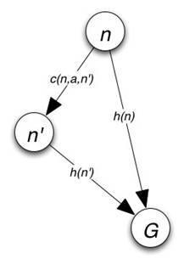
Consistency
A heuristic is consistent if
Consistency enforces that h(n) is optimistic
Theorem: if h(n) is consistent, A* using Graph-Search
is optimal
See book for details
Cost of getting from n to n’ by any action a

